Slide 1


Grammar Autocorrector Project: Dive into NLP
Want to learn the fundamentals of natural language processing (NLP)? Building a grammar autocorrector is an engaging and valuable project for students and aspiring data scientists. This project allows you to work with real-world text data, learn about language patterns, and develop practical NLP skills.
CC
by Chittem Charan

Slide 2
Project Goals and Scope
1
Practical Application
2
NLP Skills Enhancement
Develop a tool that automatically identifies and corrects grammatical errors in written text.
Gain hands-on experience with NLP concepts like tokenization, part-of-speech tagging, and language modeling.
3
Data Handling Expertise
4
Error Correction Techniques
Learn data preprocessing techniques to clean and prepare text data for analysis and model training.
Explore algorithms and approaches to identify and correct grammatical errors, such as subject-verb agreement and pronoun resolution.

Slide 3
Understanding the NLP Landscape
Tokenization
Part-of-Speech Tagging
Language Modeling
Breaking down text into individual words or units (tokens) is the first step in NLP. This helps the model understand the individual components of sentences.
Using statistical methods or deep learning, language models capture the probability of word sequences, enabling the prediction of the next word or correcting grammatical errors.
Identifying the grammatical function of each word (noun, verb, adjective, etc.) provides context and helps the model understand sentence structure.

Slide 4
Data Preprocessing: The Foundation
Data Collection
1
Gather a dataset of text containing grammatical errors. This can be from various sources like books, articles, or user-generated content.
2
Data Cleaning
Remove irrelevant information like punctuation, special characters, and stop words to prepare the data for analysis.
Data Transformation
3
Convert text into a numerical format using techniques like one-hot encoding or word embeddings. This allows models to process the data effectively.

Slide 5
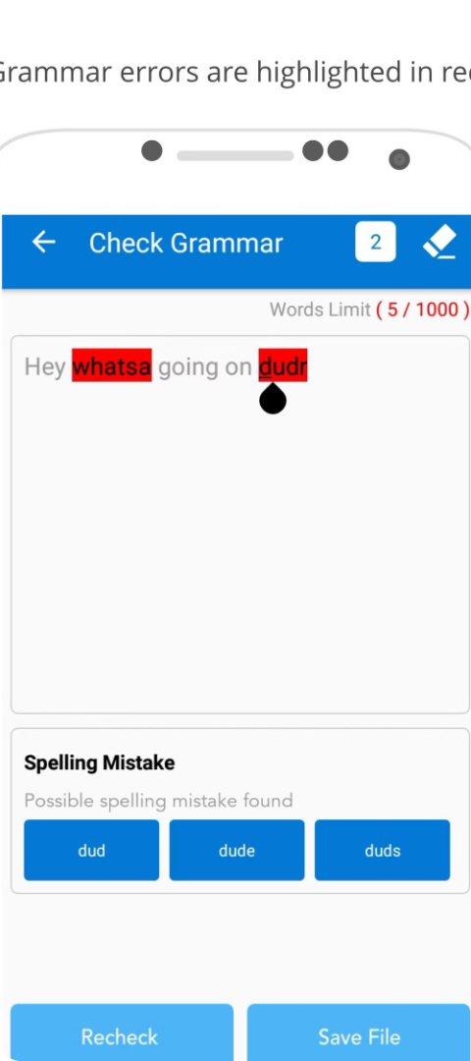



Error Identification and Correction
Rule-Based Approach
Define a set of grammatical rules and use them to identify and correct errors. This method is straightforward but may not handle complex cases.
Machine Learning
Train a machine learning model on a dataset of correct and incorrect sentences. The model learns patterns and can predict the likelihood of an error.
Deep Learning
Utilize neural networks like recurrent neural networks (RNNs) or transformer models to process text and identify grammatical errors with advanced learning capabilities.

Slide 6
Building a Grammar Autocorrector Model
Step 1
Choose a suitable NLP library (e.g., NLTK, spaCy, Stanford CoreNLP).
Step 2
Implement tokenization, part-of-speech tagging, and feature extraction based on your chosen approach.
Step 3
Train your model on the preprocessed dataset using the selected algorithm (rule-based, machine learning, or deep learning).
Step 4
Evaluate the model's performance using metrics like accuracy, precision, and recall.
Step 5
Iterate on the model's architecture, hyperparameters, and data preprocessing techniques to improve accuracy.

Slide 7
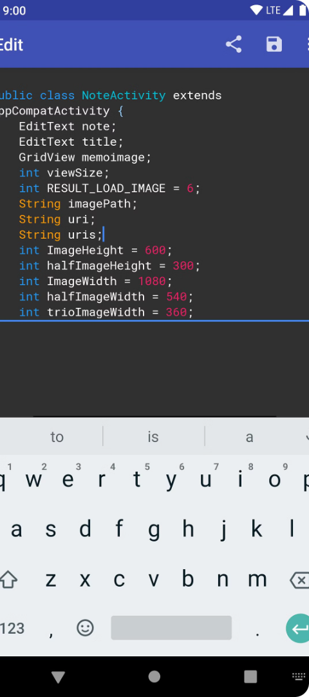
Future Scope and Applications
Personalized Grammar Correction
Real-Time Error Detection
Integrate grammar autocorrection into real-time applications like chatbots, online editors, and writing assistants.
Develop models that adapt to individual writing styles and preferences, providing personalized error correction.
Multilingual Support
Extend the capabilities of the grammar autocorrector to handle multiple languages, enhancing its applicability for global users.

Slide 8

Conclusion: The Power of NLP
This grammar autocorrector project provides an excellent starting point for learning NLP, encompassing key concepts, data handling, and model building. As you gain experience, you can explore more advanced NLP techniques and expand the functionality of your project. The applications of NLP are vast, offering exciting opportunities for innovation and real-world impact.

